Slide 1

Mission Statement We believe every individual is destined for greatness. ‘We Will Win’ is a movement rooted in faith, freedom, and fulfillment—empowering people to rise, thrive, and live their God-given purpose through the power of travel and wealth creation.

Slide 2

WE WILL WIN TEAM
GETTING STARTED SYSTEM
10 Proven Steps to Success in Your First 30 Days and Beyond
By C. Anthony Harris | Christian/Entrepreneur/Author/Mentor

Slide 3
Welcome to the We Will Win Team
200,000+
17
143
20+
Reps Built
Millionaires Created
Thousandaires
Years Experience
S.Y.S.T.E.M.
Save Yourself Stress, Time, Energy, and Money
It’s not theory. It’s not guesswork. It’s proven.
1. Be Coachable 2. Be Teachable 3. Be Learnable
"When I help you rise, I rise too." — C. Anthony Harris

Slide 4










The 10 Steps to Winning
Step 1: Determine Your Why — Your Purpose
Step 6: Plug into All Weekly Opportunity Zooms
Step 2: Set Your Goals
Step 7: Launch Your Travorium Business
Step 3: Be Committed
Step 8: Register for & Attend the Next International Event
Step 4: Build Your List & Get Your 3 for FREE
Step 9: Become Familiar with Your Website & Back Office
Step 5: Contact and Invite — Pique Interest
Step 10: R&D — Rip Off and Duplicate the System
Follow these steps exactly. Don’t skip. Don’t rearrange. Trust the system.

Slide 5
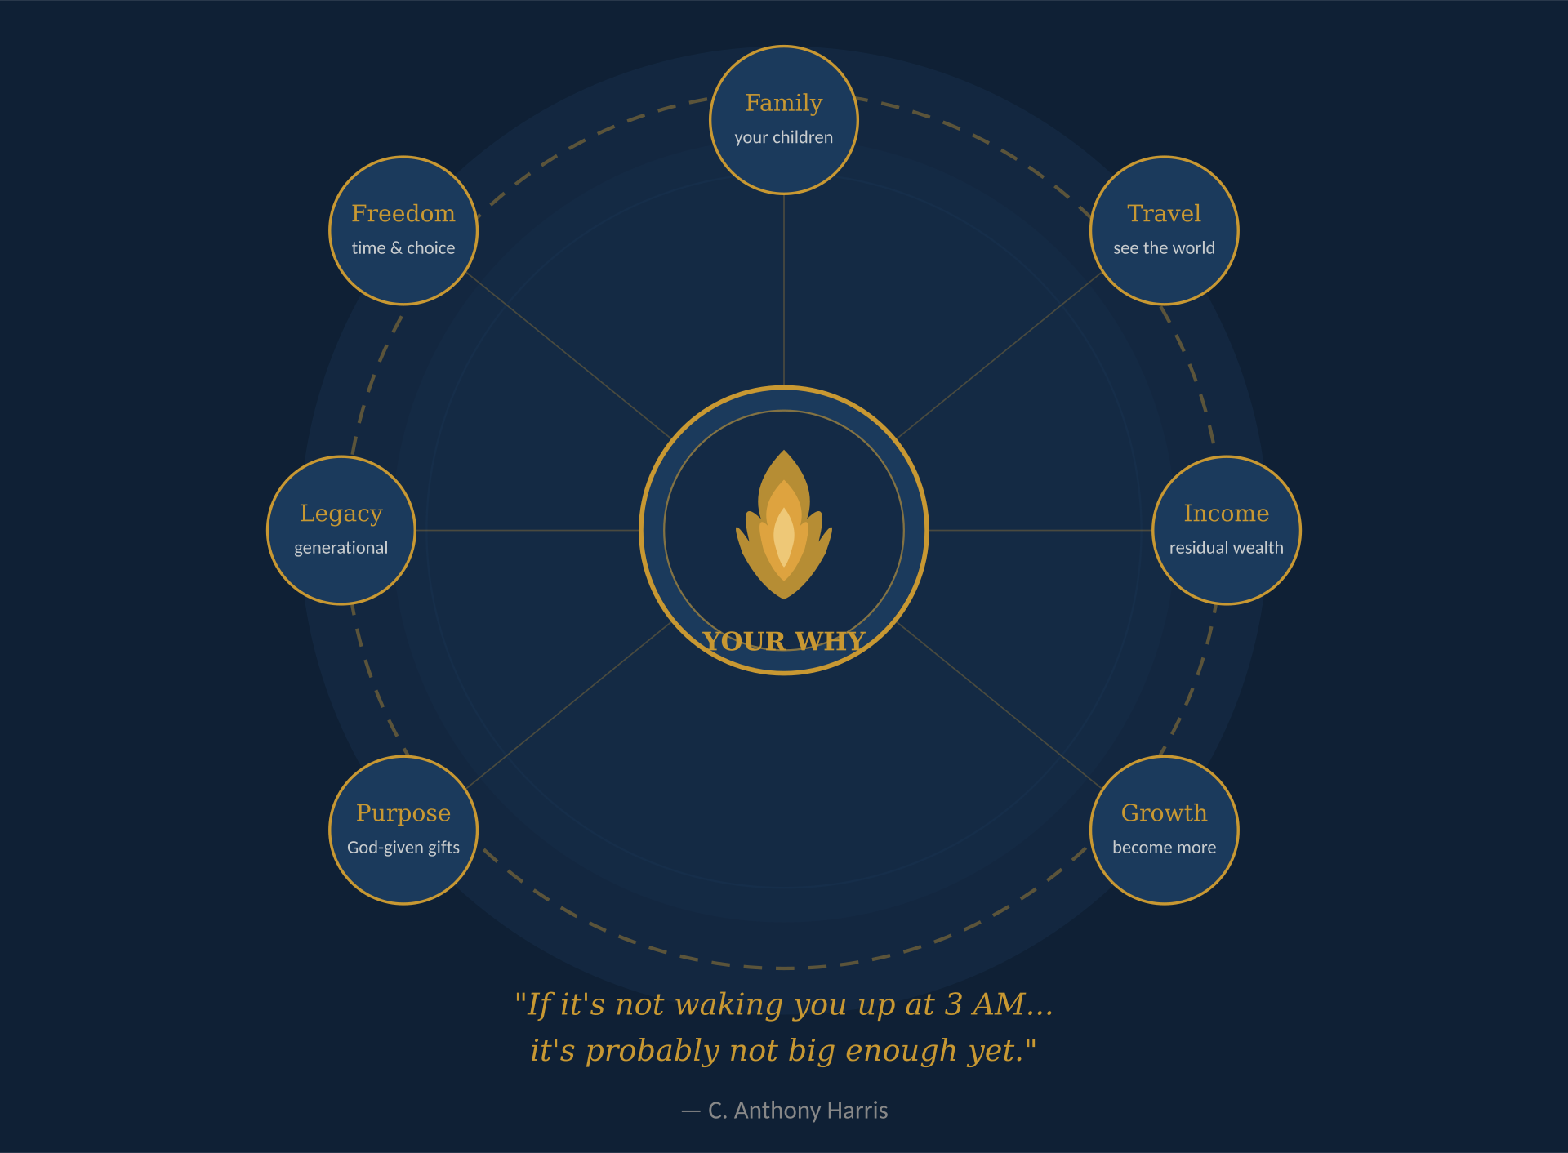
Step 1: Determine Your Why — Your Purpose
This is the MOST important step — that’s why it’s Step 1
Find a why so deep inside you that it hurts
If it’s not waking you up at 3 AM, it’s not big enough yet
Is it your kids? Your family? Freedom? Being your own boss?
Your why keeps you going when things get tough
ACTION STEP: Write it down. Say it out loud. Share it with your upline leader.
Pro-tip: Get familiar with your Back Office, navigate through it daily, click on all the features.

Slide 7
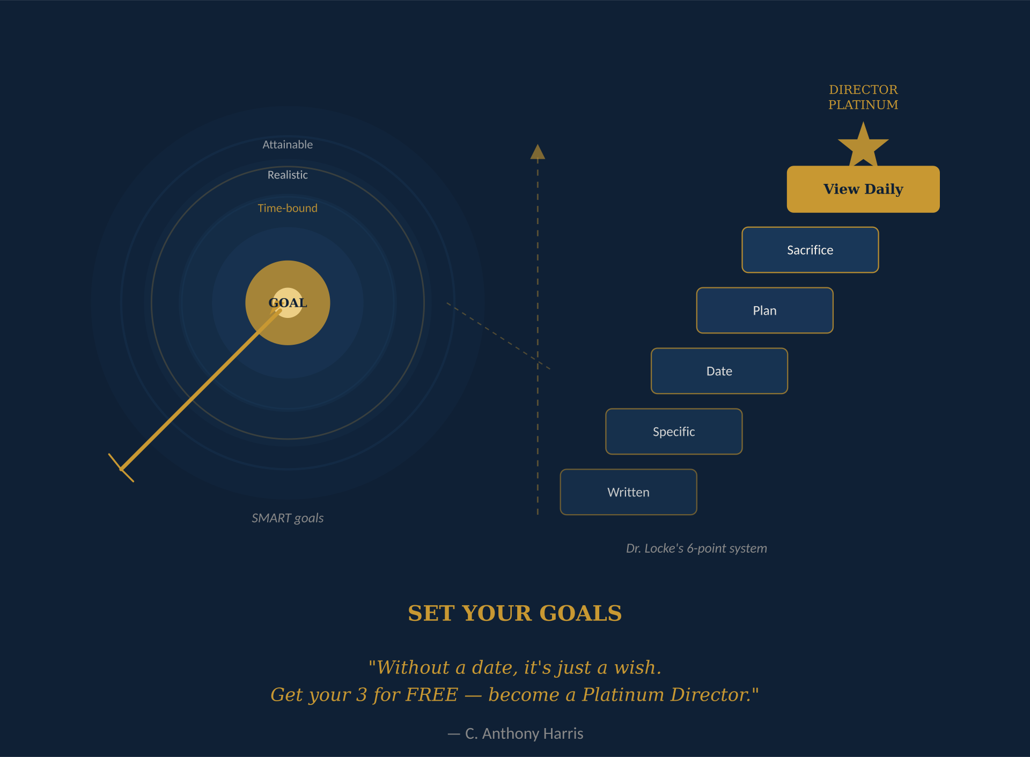
Step 2: Set Your Goals
SMART Goals: Specific, Measurable, Attainable, Realistic, Time-Bound
Dr. Edwin Locke’s 6-Point System: Written, Specific, Date, Plan, Sacrifice, View Daily
Priority #1: Get your 3 for FREE and become a Platinum Director
Where do you want to be in 30 days? 90 days? One year?
Read your goals EVERY single day
ACTION STEP: Write down your goals NOW. Share them with your upline leader.
Pro-tip: Get familiar with your Back Office, navigate through it daily, click on all the features.

Slide 9
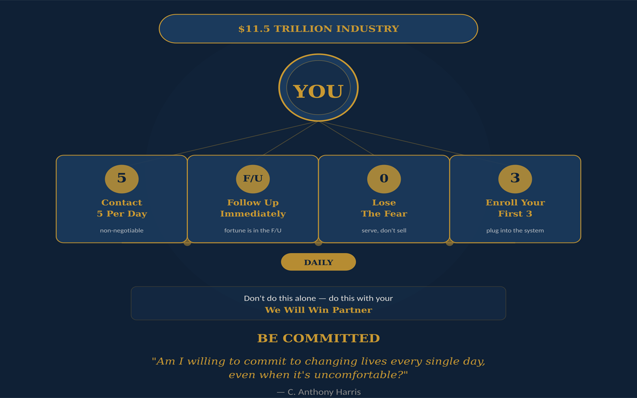
Step 3: Be Committed
You are in an 11.5 TRILLION-dollar industry — show up daily
4 Daily Commitments:
1) Contact 5 people per day — non-negotiable
2) Follow up IMMEDIATELY after they review the overview
3) Lose the fear — you’re serving, not selling
4) Enroll and activate your first 3 members
ACTION STEP: Write your Daily Action Plan on paper. Don’t do this alone.
Pro-tip: Get familiar with your Back Office, navigate through it daily, click on all the features.

Slide 10
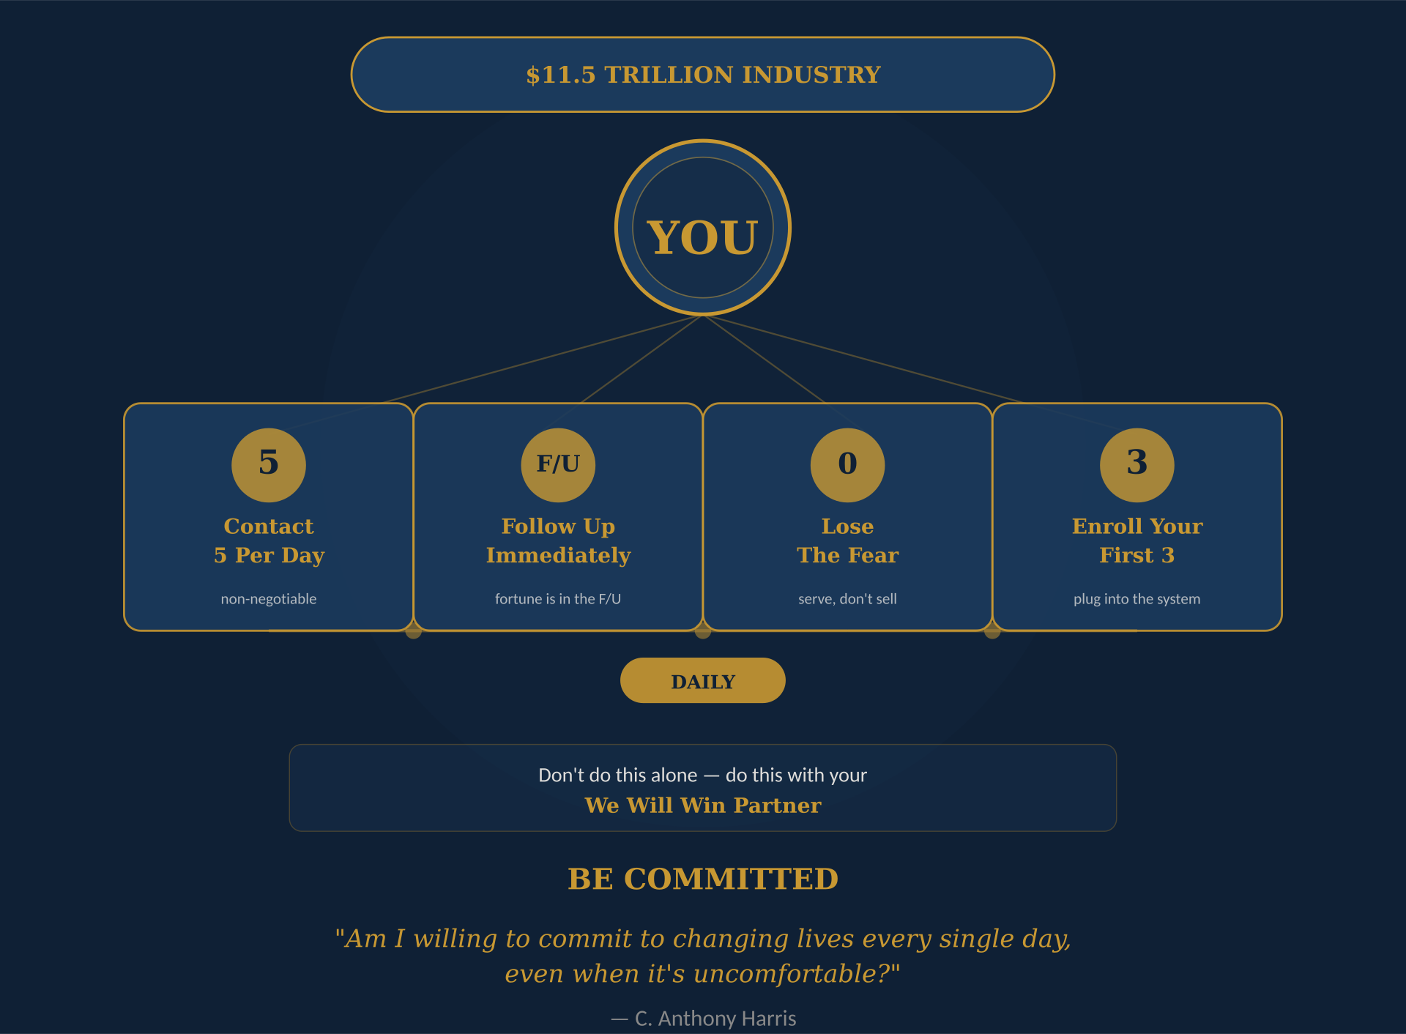

Slide 11
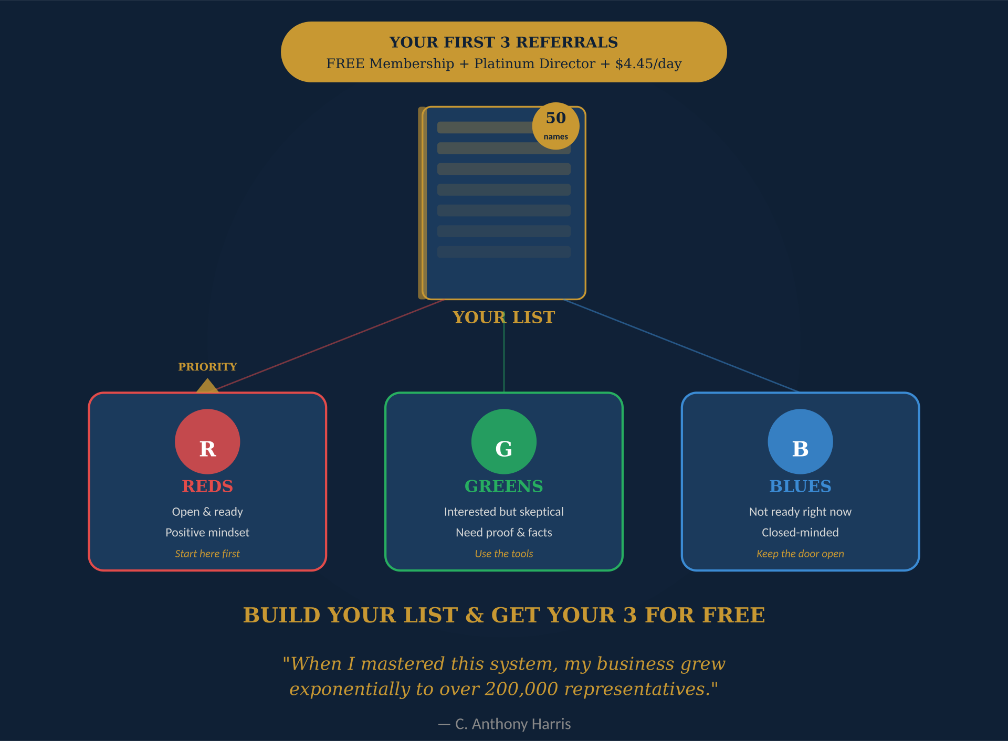
Step 4: Build Your List & Get Your 3 for FREE
Your first 3 referrals makes your membership FREE + Platinum Director + $4.45/day residual Income
The Color System — categorize everyone on your list:
🔴 Reds — Open & ready. Start here.
🟢 Greens — Interested but skeptical. Use the tools.
🔵 Blues — Not ready. Keep the door open. Move on.
Aim for at least 50 names to start
ACTION STEP: Build your list NOW. Share it with your upline leader to prioritize your Reds.
Pro-tip: Get familiar with your Back Office, navigate through it daily, click on all the features.

Slide 13
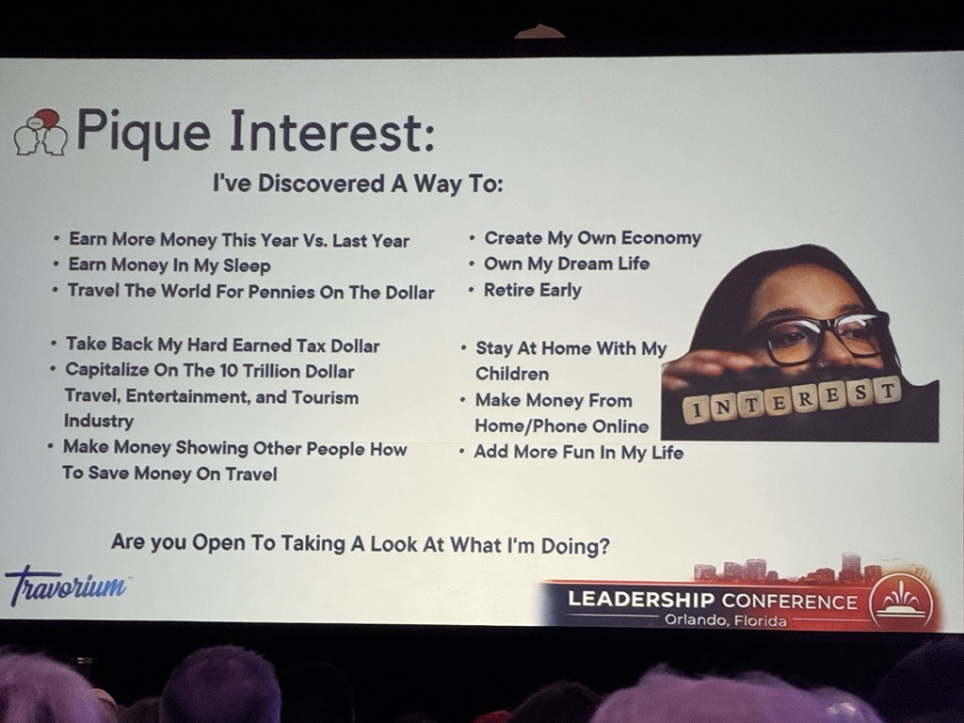
Step 5: Contact and Invite — Pique Interest
Real prospecting = phone calls & face-to-face. NOT text blasts.
Everywhere I go, I’m prospecting and inviting
Look for: Friendly, Happy, Like-minded, Servants, Fun people
Use the Piquing Interest Script: “I’ve discovered a way to...”
“Are you open to taking a look at what I discovered?”
End with: “You Gotta See This…”
Some Will, Some Won’t, So What, NEXT!
ACTION STEP: Practice your script. Contact and invite daily. Gamify piquing interest!
Pro-tip: Get familiar with your Back Office, navigate through it daily, click on all the features.

Slide 14
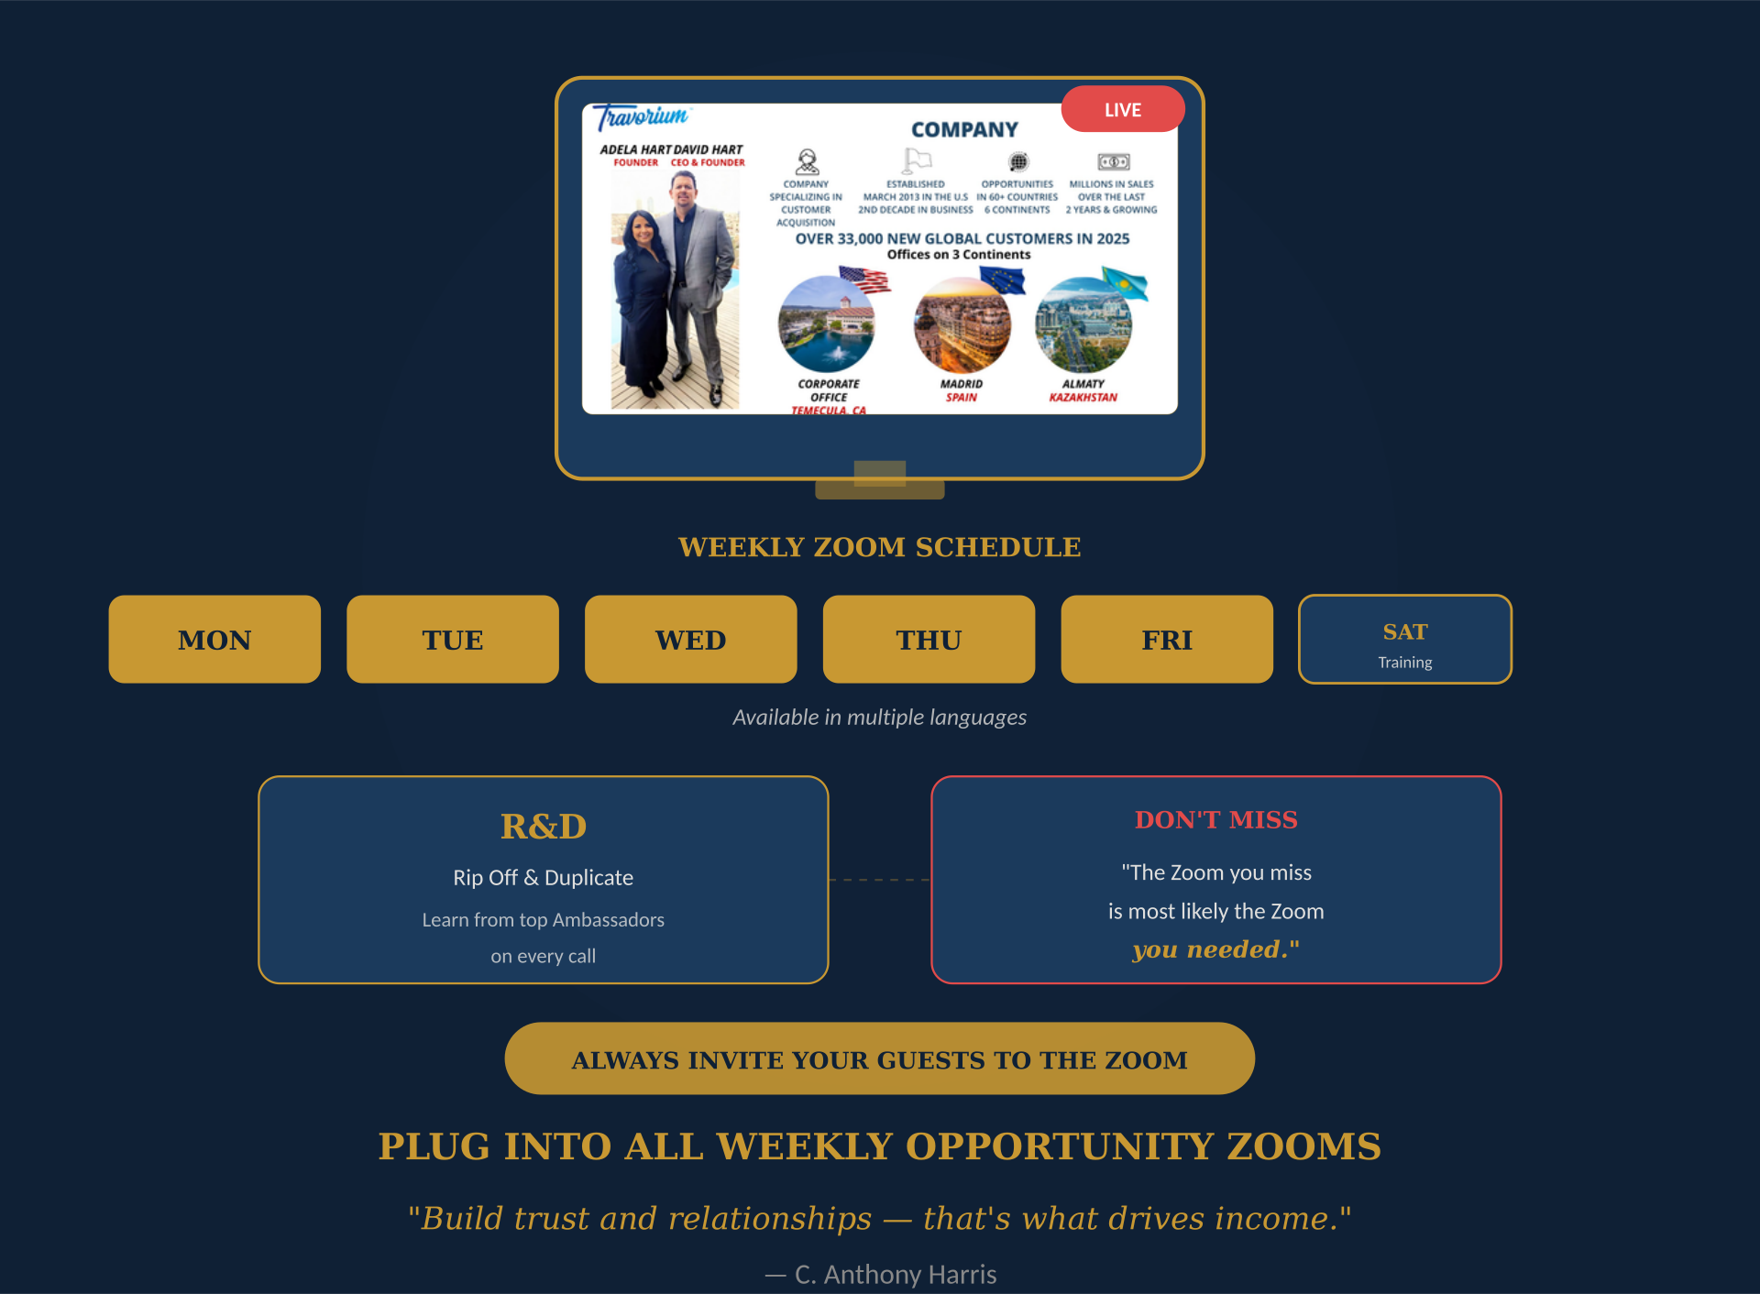
Step 6: Plug into All Weekly Opportunity Zooms
Weekly Zooms: Monday – Friday (multiple languages) + Saturday training
R&D — Rip Off and Duplicate what top Ambassadors are doing
The Zoom you miss is most likely the Zoom you needed
Build trust and relationships — that’s what drives income
Always invite your guests to the Zoom
If guests can’t make the schedule — request a private Zoom
ACTION STEP: Make weekly Zooms non-negotiable. Invite guests to every call.
Pro-tip: Get familiar with your Back Office, navigate through it daily, click on all the features.

Slide 16
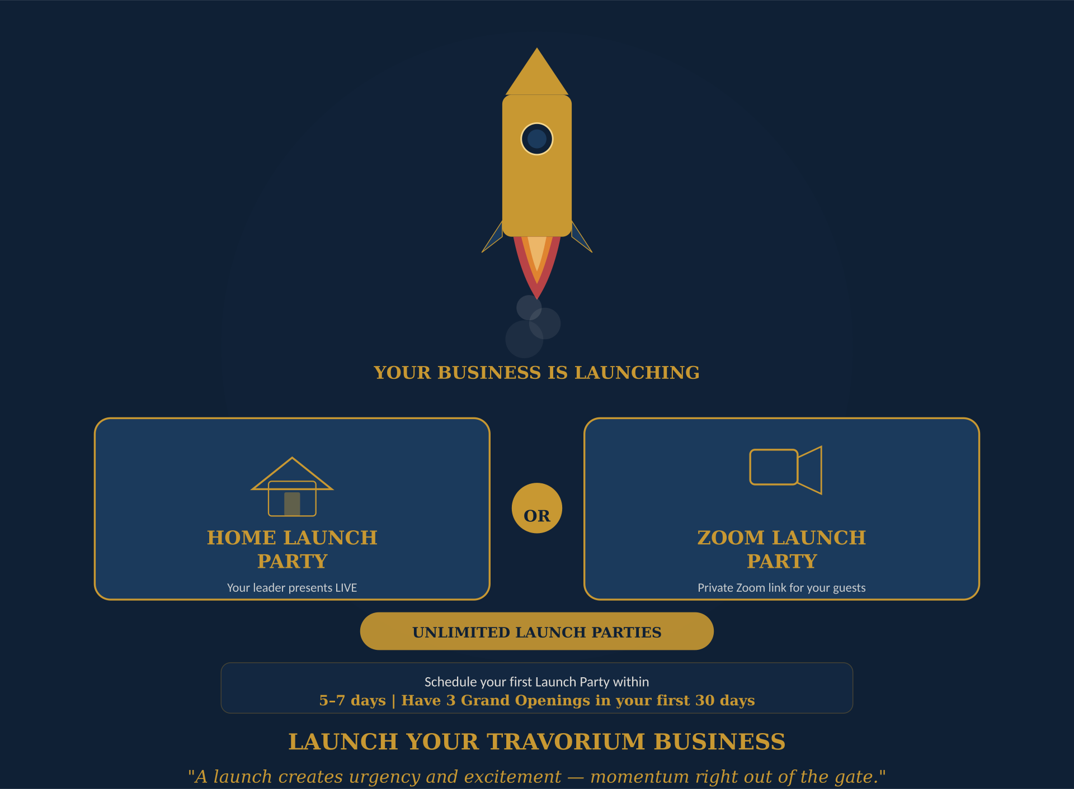
Step 7: Launch Your Travorium Business
A launch creates URGENCY and EXCITEMENT
Two ways to launch:
Home Launch Party — Your leader presents LIVE in your home
Zoom Launch Party — Your leader provides a private Zoom link
You can do UNLIMITED launch parties
Your team leaders will plan, prepare, and provide all the tools
ACTION STEP: Schedule your first Launch Party within 5–7 days. Have 3 Grand Openings in 30 days.
Pro-tip: Get familiar with your Back Office, navigate through it daily, click on all the features.

Slide 18

Step 8: Register for the Next International Event
Travorium International Events: twice per year (February & August)
Next event: Las Vegas, Nevada
A powerful two-day experience to elevate your business:
Get promoted and cross the stage
Meet the entire Travorium & We Will Win team worldwide
Gain strategies from Ambassadors to accelerate your results
ACTION STEP: Go into your back office and register TODAY for the Early Bird Special.
Pro-tip: Get familiar with your Back Office, navigate through it daily, click on all the features.

Slide 19
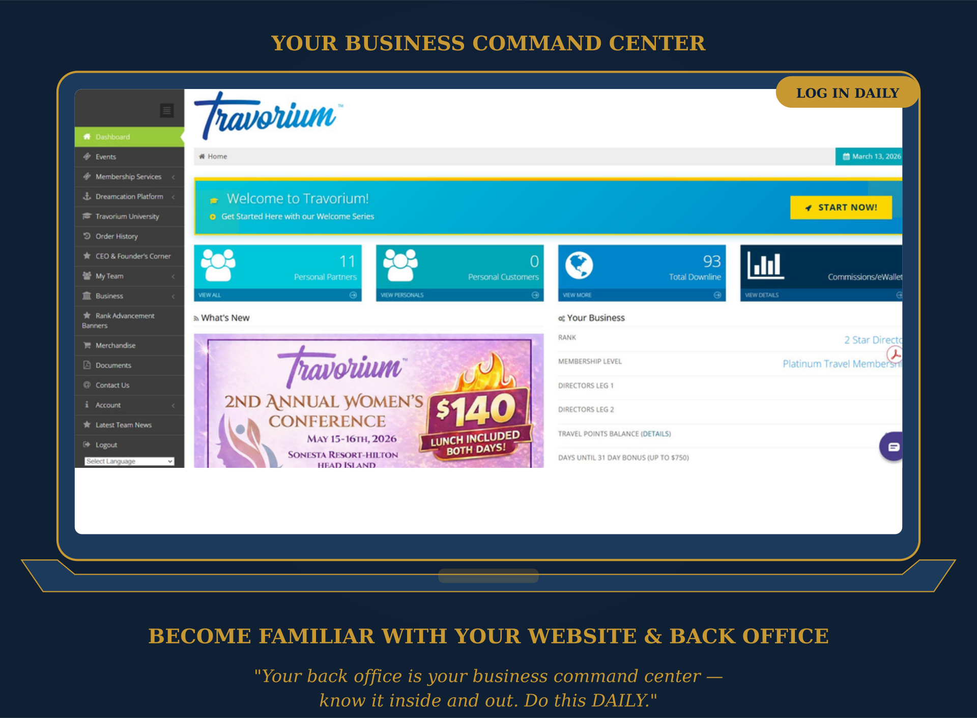
Step 9: Your Website & Back Office
Your back office is your business command center
7 Steps to get started:
1) Log on at www.travorium.com/ID
2) Click “Partner Login” — enter email & password
3) Verify your identity
4) Complete the Welcome to Travorium Series
5) Explore all Menu Tabs — do this DAILY
ACTION STEP: Log in daily. Know your back office inside and out. Ask your leader if you need help.
Pro-tip: Get familiar with your Back Office, navigate through it daily, click on all the features.

Slide 20
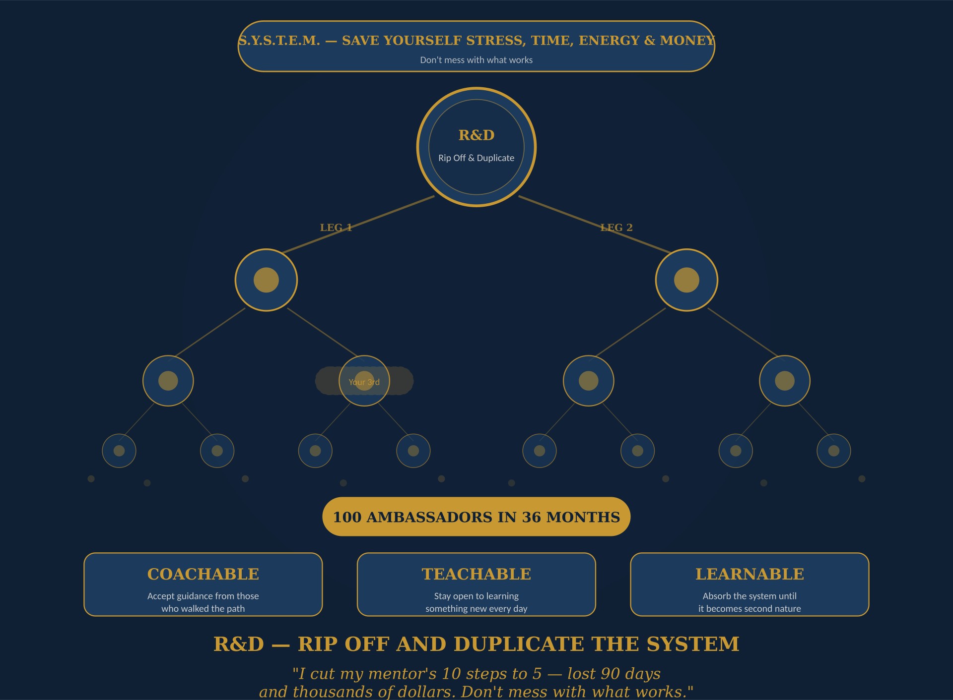
Step 10: R&D — Rip Off and Duplicate
Duplication is the KEY — it works in both directions
If you mess it up, your team messes it up too
My lesson: I cut my mentor’s 10 steps to 5 — lost 90 days + thousands of dollars
S.Y.S.T.E.M. — Save Yourself Stress, Time, Energy, and Money
Be Coachable. Be Teachable. Be Learnable.
Your job now: TEACH this same system to every new partner
ACTION STEP: Follow the system EXACTLY. Duplicate it. That’s how we create 100 Ambassadors.
Pro-tip: Get familiar with your Back Office, navigate through it daily, click on all the features.

Slide 22
YOU’VE COMPLETED THE SYSTEM!
Now go teach it, live it, and duplicate it.
100 Ambassadors in 36 Months
WE WILL WIN!
C. Anthony Harris | Christian/Entrepreneur/Author/Mentor

